Slide 1
9. FPGA architecture
Fondamenti di Elettronica
Sergio Spanò – spano@ing.uniroma2.it

Slide 2
FPGA introduction
Field Programmable Gate Arrays (FPGAs) are semiconductor devices based on a matrix of Configurable Logic Blocks (CLBs) connected via programmable interconnects.
They can be reprogrammed to match a desired application or some functionality requirements. This feature distinguishes FPGAs from Application Specific Integrated Circuits (ASICs).
One-time programmable (OTP) FPGAs are also available
The dominant type is SRAM based which can be reprogrammed as the design evolves

Slide 3
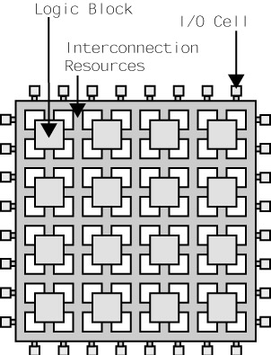
FPGA Architecture
FPGAs are composed by
Logic Blocks
Reconfigurable interconnects
General purpose I/O
More complex FPGA may have
Block Ram
DSP Block
Tranceivers
Clock manager devices
Microprocessors

Slide 4
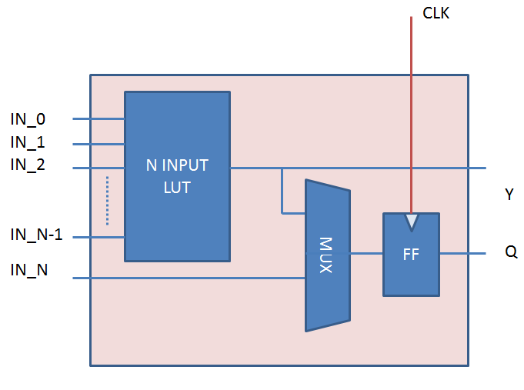
Logic blocks
Logic and arithmetic operations are performed by the Logic Blocks. They are composed by:
N-input LUT (LookUp Table) usually SRAM based,
A register suitable as latch or flip flop
A multiplexer
Each FPGA contains a large number of Logic Blocks that can be used to make different functions.
The function implementation is obtained programming the LUT with the desidered truth table

Slide 5
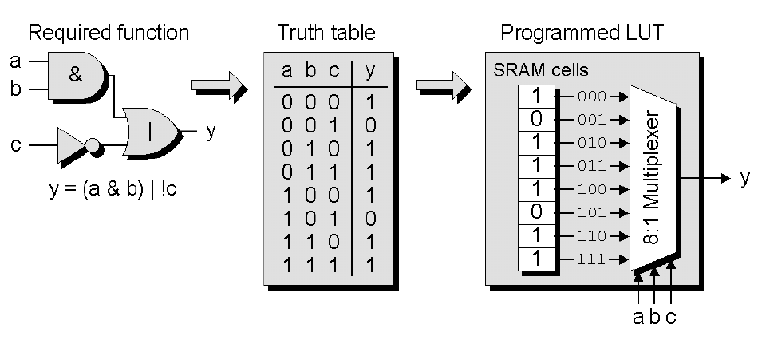
Logic blocks programming
Suppose that we have a 3-Input LUT(modern FPGAs have up to 6-input LUT)
We are required to perform the function: Y=AB+C’
This function can be obtained from the 3-INPUT LUT mapping its truth table on the LUT’s SRAM cells

Slide 6
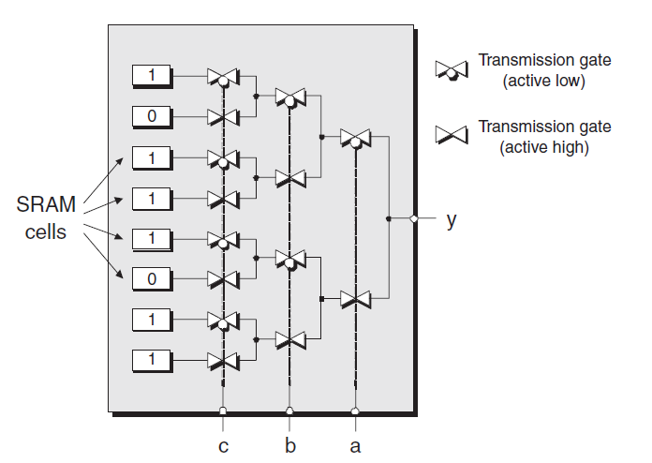
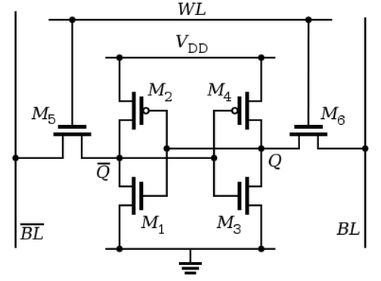
Logic blocks LUT
SRAM based LUTs are composed by
SRAM cells
Trasmission gate multiplexer

Slide 7
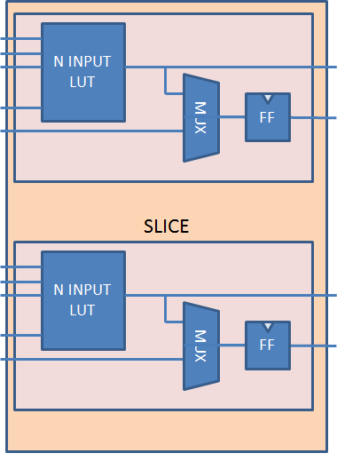
Slices of logic blocks
Some FPGA vendors like AMD-Xilinx organize the Logic Blocks in a hierarchy
in Xilinx devices, groups of two or four (depending on device) Logic Blocks are called Slices.
The Logic Blocks contained in the same Slice share the same control signal (Enable, Clock, Reset, …).

Slide 8
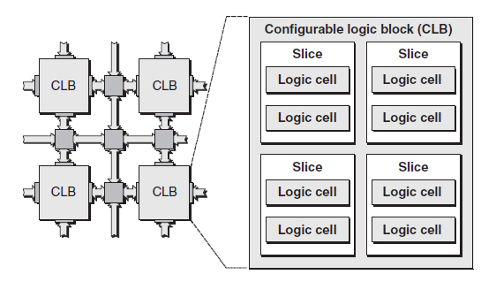
Configurable Logic blocks
Slices are grouped together. In Xilinx devices, a group of Slices is called CLB (Configurable Logic Block)
There are some fast interconnects within the CLB.
The Logic Block hierarchy follows the interconnect hierarchy. In fact, local routing provides feedback between slices in the same CLB, and it provides routing to neighboring CLBs.

Slide 9
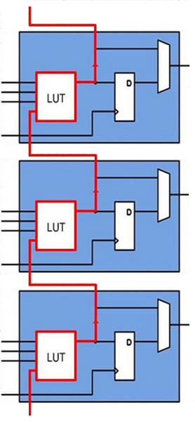
Fast carry chain
Logic Blocks can be used for arithmetic operations ➔ close slices are connected by a fast carry chain.
If the Slices are used to implement an adder, the carry propagate using a dedicated interconnect characterized by a very high speed.

Slide 10
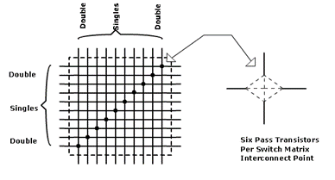
Interconnects
Interconnects are the programmable network of signal pathways between the inputs and outputs of functional elements.
There are different kinds of interconnects: Global and Local interconnects
Local Interconnect are suitable for neighbor CLBs

Slide 11
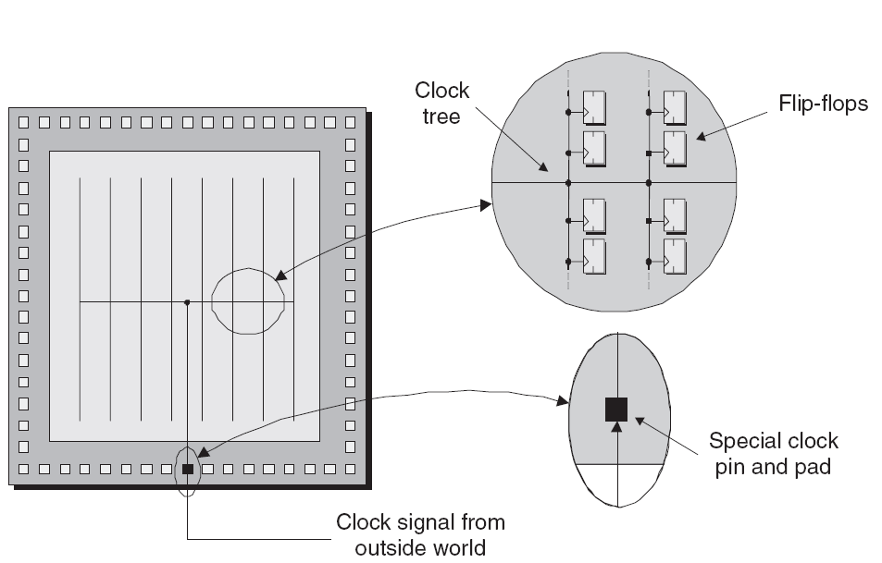
Clock line
Synchronous elements inside the FPGA must be driven by a clock signal which is typically originated from the outside.
Clock must arrive at the same time to different registers in order to avoid the skew.
For this reason, flip flop and clock line are organized in trees
Clock trees use special lines, they are separated from the general purpose interconnects

Slide 12
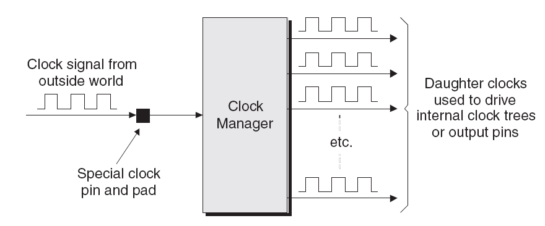
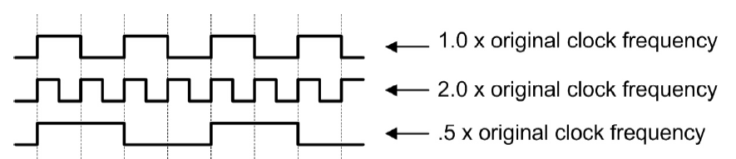
Digital Clock Managers
DCM (Digital Clock Managers) are circuits used to :
Multiply and divide an incoming clock (DFS).
Recondition a clock
Phase shift (DLL).
Eliminate clock skew.

Slide 13
Block RAMs
Lot of applications require the use of memory
modern FPGAs include embedded RAM called Block Ram (BRAM)
This solution avoids the using of distributed RAM. Distributed RAMs are implemented using a parallel array of large number of Logic Elements.
This makes distributed RAM ideal for small sized memories, but when comes to large memories, this may cause an extra wiring delays and CLB wasting.
Block RAM's size is fixed, so if a memory is implemented using these devices there is a wasting of the rest of the space in RAM.
For this reason, it is better use block RAMs for large sized memories and distributed RAM for small sized memories

Slide 14
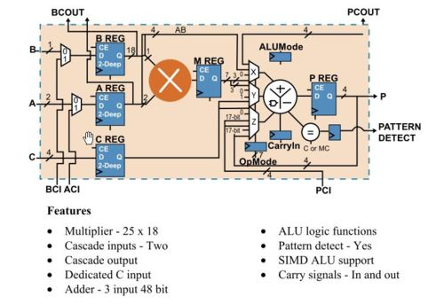
Digital Signal Processing blocks
DSP operations can be implemented using the FPGA Logic Elements
They would require a large number of resources.
The great amount of required resources impacts on routing complexity and power consumption.
Some FPGA include dedicated hardware resources to perform DSP

Slide 15
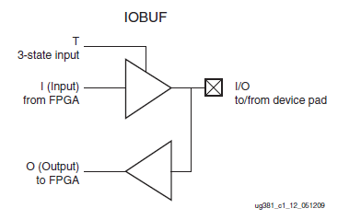
FPGA I/O
The I/O pins of an FPGA can be configured to various standards, both single-ended and differential.
Single-ended I/O standards: LVCMOS, LVTTL, HSTL, PCI, and SSTL
Differential I/O standards: LVDS, Mini_LVDS, RSDS, PPDS, BLVDS, and differential HSTL

Slide 16
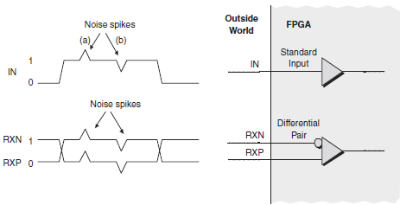
Single ended vs Differential
Single-ended signals are usually are more sensitive to noise than differential signals

Slide 17
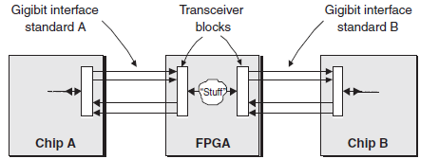
Tranceivers
Communications between FPGAs and other chips require high speed, for this reason specific circuits are used (transceiver).
Parallel I/O schemes reach physical limitations when data rates begin to exceed just 1 Gb/s
Serial I/O-based designs offer fewer device pins, reduced board space requirements, fewer printed circuit board (PCB) layers, easier layout of the PCB, smaller connectors, lower electromagnetic interference, and better noise immunity.

Slide 18
Soft and Hard Microprocessors
Digital systems often require both processors and FPGAs
Usually, the processor handles system control and configuration functions while the FPGA implements the computationally-intensive signal processing data path and control, minimizing the latency in the system.
Last generations of FPGAs offer the possibility of using Soft and Hard Processor.
A soft processor is a processor mapped on the FPGA resources (CLBs) on the other hand
Hard processor is a silicon core integrated on the FPGA.
Of course, the performances of Hard processor in terms of clock frequency are higher than those of a Soft Processor because dedicated hardware is always more optimized than reconfigurable one
However, if the performance requirements of the system are not too high it is possible to use a soft processor that is more cost-efficient.

Slide 19
FPGA deployment flow
System description
Test-bench
Synthesis
Mapping
Packing
Place and Route
Post Place and Route simulation
Bit-stream generation and devices configuration.

Slide 20
System description
The system to be implemented on the FPGA is described in terms of components using three different approaches:
HDL Languages: HDL (Hardware Description Language) are a class of computer languages, specification languages, or modeling languages for formal description and design of electronic circuits, and most commonly, digital logic.
VHDL
Verilog
System Verilog
Schematic tools: in the last years new tools that allow the HDL automatic generation starting from Simulink Models were introduced .
MATLAB HDL coder,
Xilinx System Generator
Altera DSP Builder.
HLS languages (High Level Synthesis): it is an automated design process that takes an abstract behavioral specification (usually in C++ language) of a digital system and finds a register-transfer level structure that realizes the given behavior. This is then translated to an HDL.
Vivado HLS
Catapult C

Slide 21
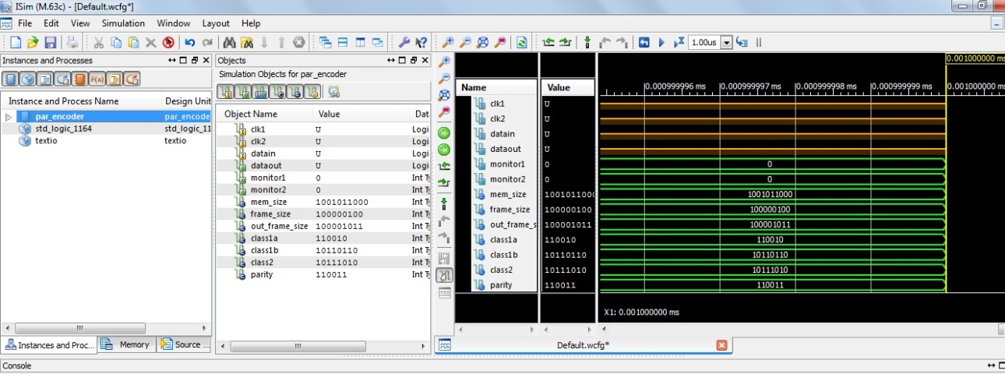
Test-bench
Once that the model was described in HDL, it must be simulated in order to evaluate the correct behaviour.

Slide 22
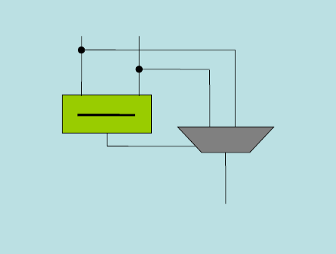
Synthesis
This process transforms the HDL model into a netlist of objects (typically logic gates)
Synthesis is performed by a specific tool called synthesizer.
If a-b >0 then
max=a
else
max=b

Slide 23
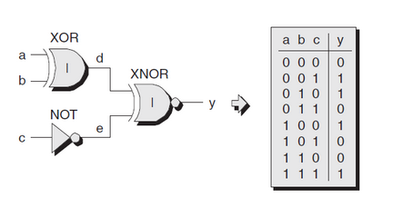
Mapping
The netlist generated during the Synthesis is divided in sub-circuits having the number of inputs equal to the ones of LUT in the FPGA logic blocks.
For each sub-circuit, the truth table is estimated and is mapped in a LUT

Slide 24
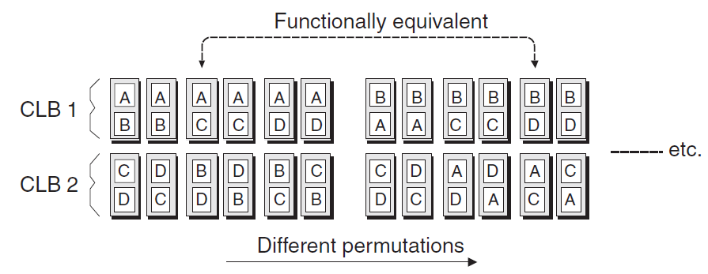
Packing
Logic Blocks are packed into the FPGA CLB.
There are myriad potential combination and permutations.

Slide 25
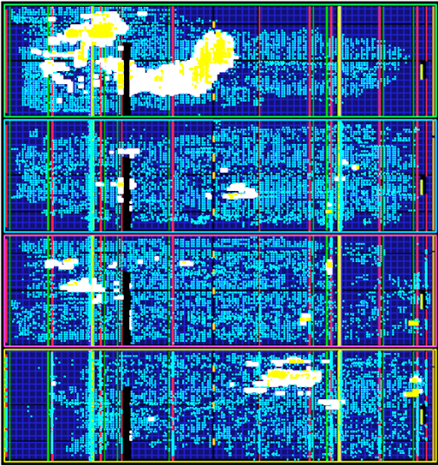
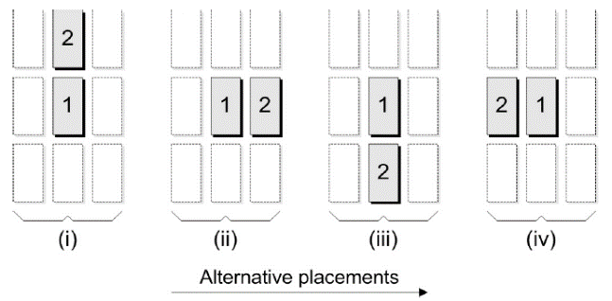
Place and Route
The CLBs are placed and routed into the devices. In this phase, the Maximum clock frequency and area are estimated.

Slide 26
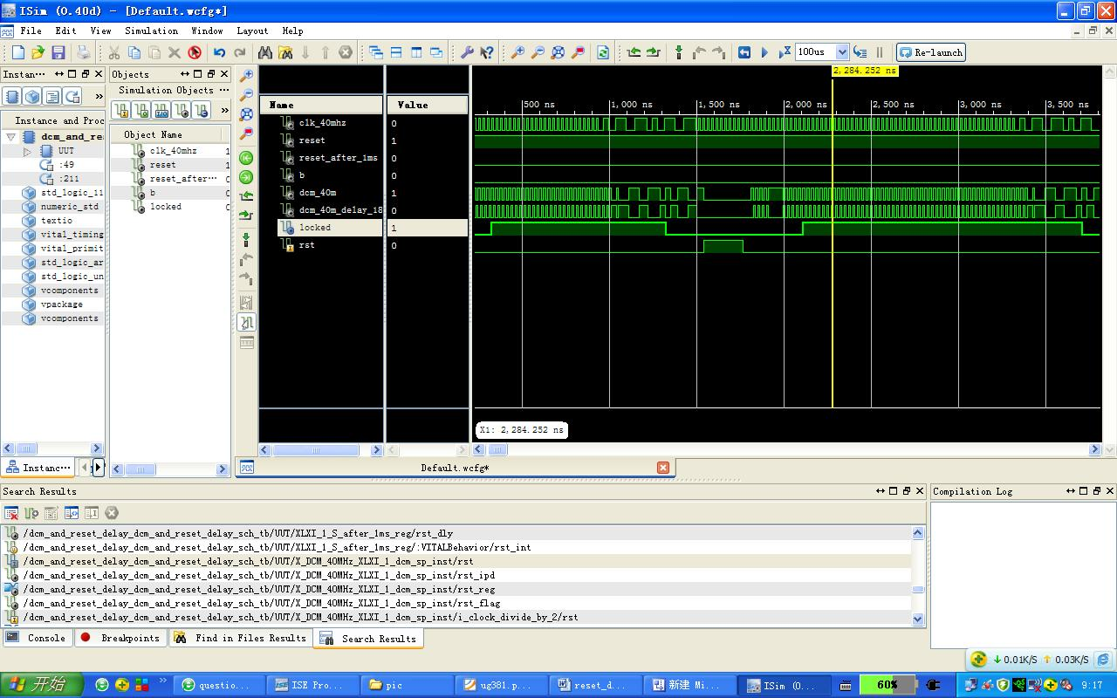
Post Place and Route simulation
During the Place and Route all the path delay are estimated, for this reason it can be useful perform another simulation that take into consideration the delays of all the paths.

Slide 27
Bit-stream generation and device configuration
Final steps of the FPGA design flow
Bit-stream generation
The device configuration
Using a JTAG chain, all the bits needed to program all the devices inside the FPGA are injected inside its flip flops, LUTs, DSPs,…
The FPGA is ready to use

